Slide 1
Standard Configurations of Charge
Point charge
Several point charges
Line of Charge
Semi-infinate sheet of charge
Charged sphere
Charged spherical shell
Ring of Charge

Slide 3
y
q₁
Two charges are separated by a distance d. What is the field a distance L from the center of the two charges?
r
θ
d
L
θ
P
z
r
q₂

Slide 4
y
q₁
r
E₁
E₂
θ
d
L
θ
P
z
r
q₂

Slide 5
y
q₁
r
E
E₁
E₂
θ
d
L
θ
P
z
r
q₂

Slide 6
E₁
E
E₂
q₁
r
θ
d
L
θ
P
q₂
r

Slide 8
q₁
Dipole Moment
q₂

Slide 9
q₁
y
Three charges are separated by a distance d as shown. What is the field a distance L from the center of the two charges?
d
q₂
E₃
θ
L
θ
E₂
P
z
E₁
d
q₃

Slide 10
q₁
y
d
q₂
E₃
θ
E
L
θ
E₂
P
z
E₁
d
q₃

Slide 11
- - - - - - - - - - - - - - - - - - - - - - - - - -
- - - - - -- - - - - -

Slide 13
- - - -
- - - - - -
- - - - - - -
- - - - - - - -
- - - - - - -
- - - - - -
- - - -

Slide 14
+
+
+
+
+
+
+
+
+
+
+
+
+
+
+
+

Slide 16
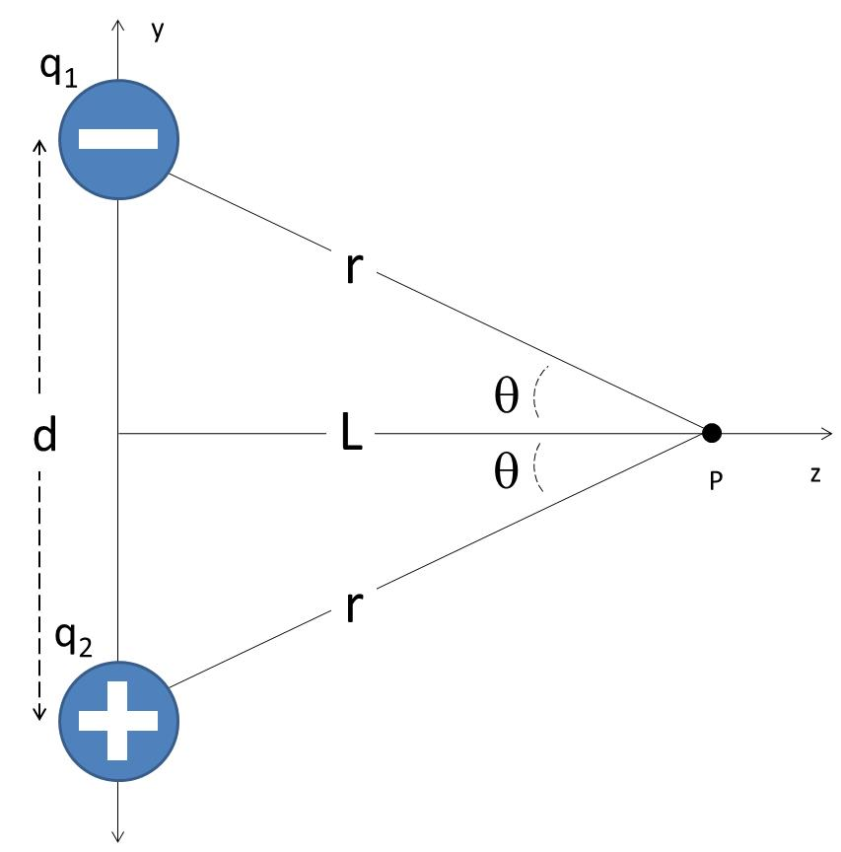
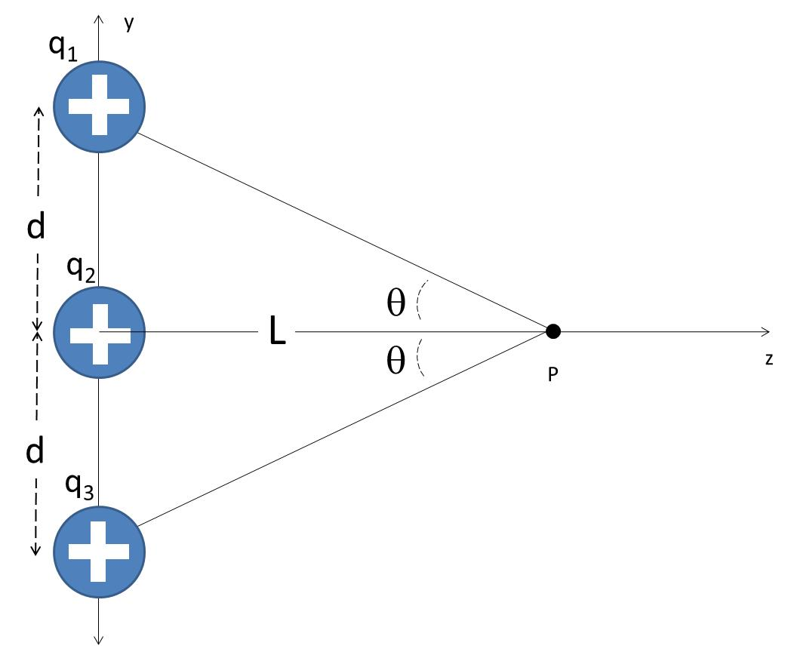
Find the field find due to two charges, one positive and one negative, at a point, P, along the axis between the two charges as shown to the right.
What is the field if L is very large
Find the field find due to two three positive charges at a point, P, along the axis shown to the right
What is the field if L is very large

Slide 17
q₁
y
d
q₂
θ
L
θ
z
P
d
q₃

